Slide 1
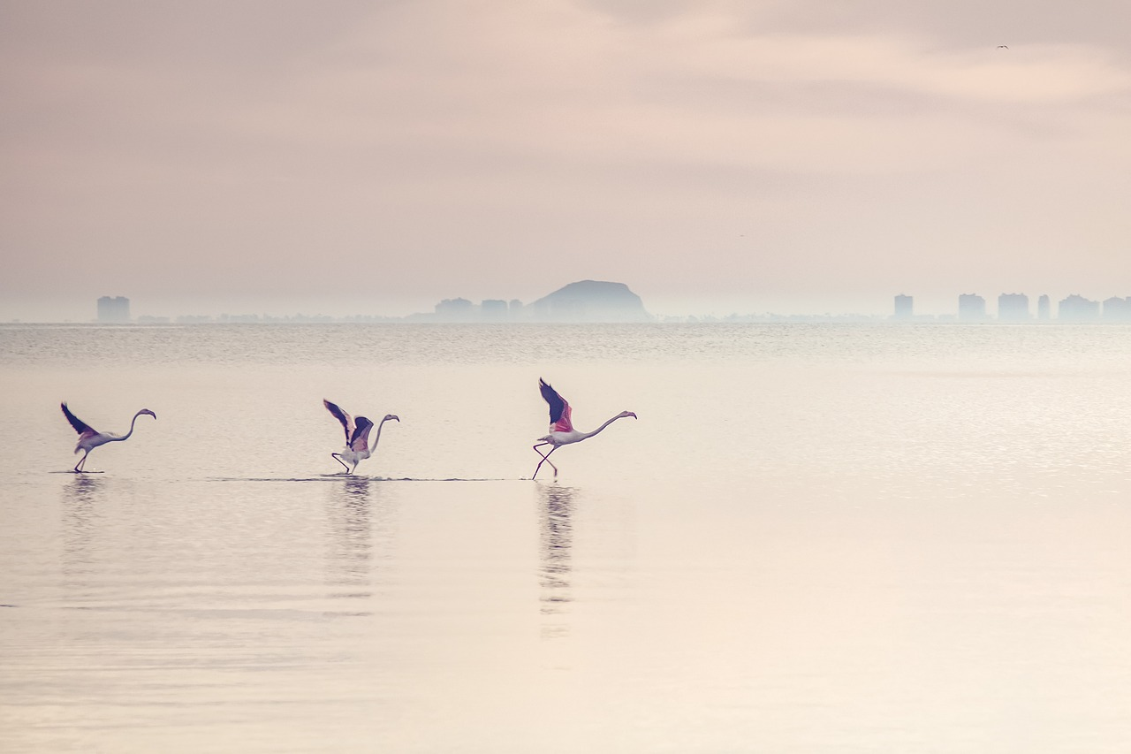
Data Visualization of Bird Strikes in US between 2000-2011

Slide 2

PROBLEM STATEMENT
Transport and communication are in the crucial domain in the field of analytics. Environmental impacts and safety are, nowadays, two major concerns of the scientific community with respect to transport scenarios and to the ever-growing urban areas. These issues gain more importance due to the increasing amount of vehicles and people. Seeking new solutions is reaching a point where available technologies and artificial intelligence, especially MAS, are being recognized as ways to cope with and tackle these kinds of problems in a distributed and more appropriate way.
A bird strike is strictly defined as a collision between a bird and an aircraft which is in flight or on a take-off or landing roll. The term is often expanded to cover other wildlife strikes - with bats or ground animals. Bird Strike is common and can be a significant threat to aircraft safety. For smaller aircraft, significant damage may be caused to the aircraft structure and all aircraft, especially jet-engine ones, are vulnerable to the loss of thrust which can follow the ingestion of birds into engine air intakes.
This has resulted in several fatal accidents. Bird strikes may occur during any phase of flight, but are most likely during the take-off, initial climb, approach and landing phases due to the greater numbers of birds in flight at lower levels. To have a closer look the following document visually depicts the data collected on Bird Strikes by FAA between 2000-2011.

Slide 3
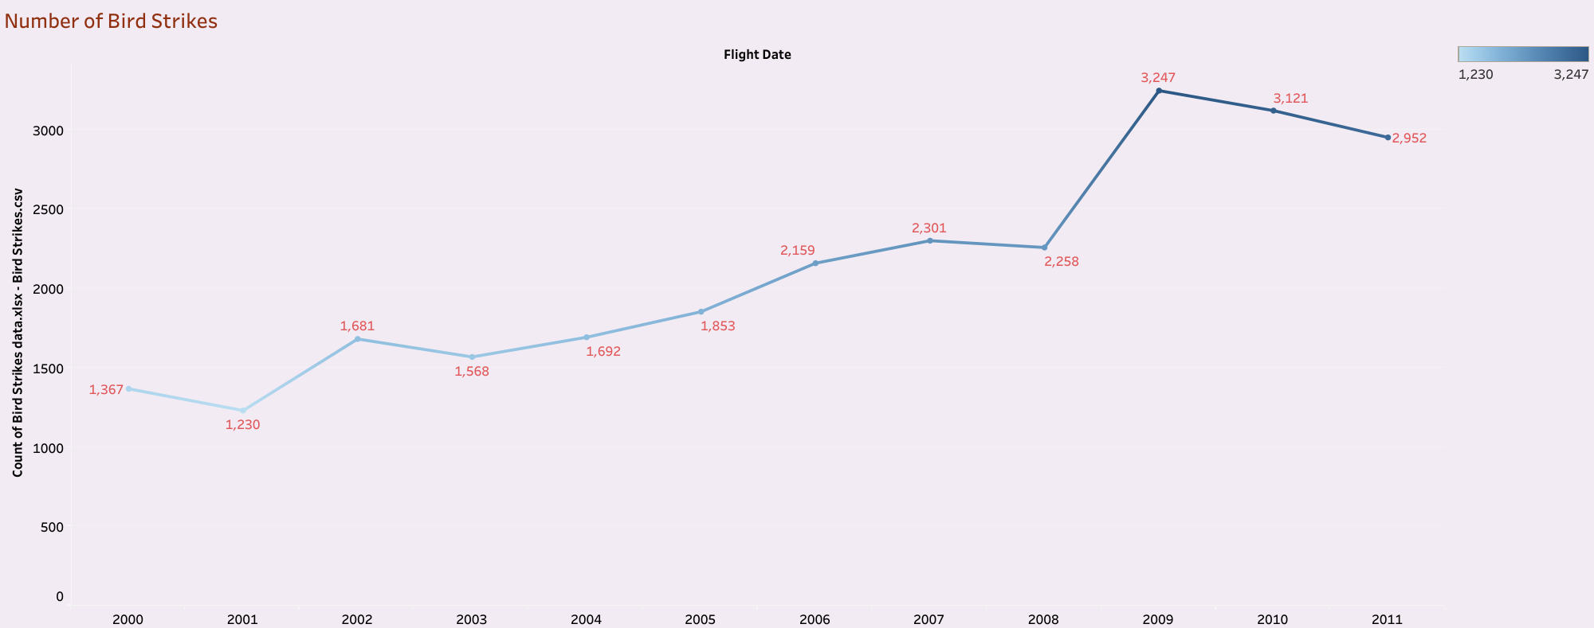
BIRD STRIKES IN EVERY YEAR

Slide 4
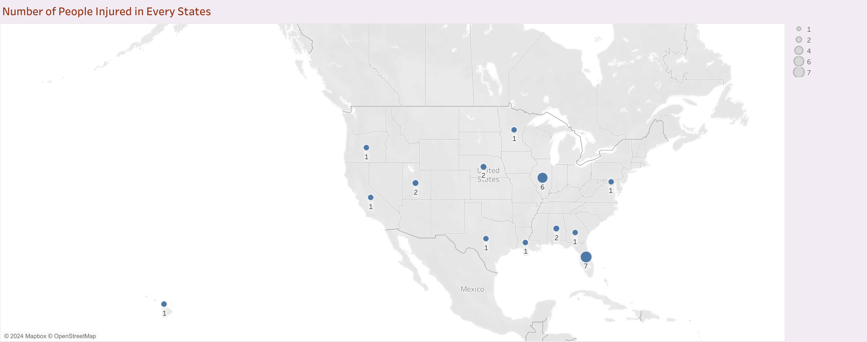
PEOPLE INJURED IN EVERY STATE

Slide 5
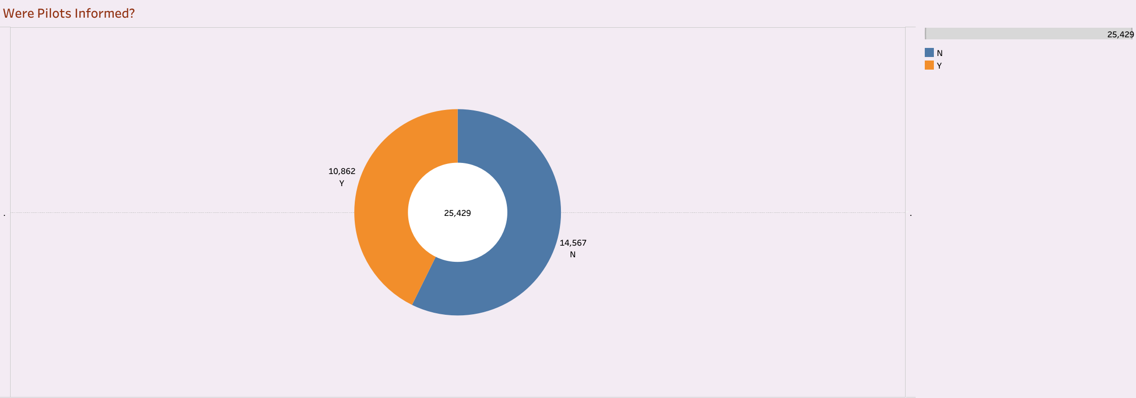
WERE PILOTS INFORMED?

Slide 6
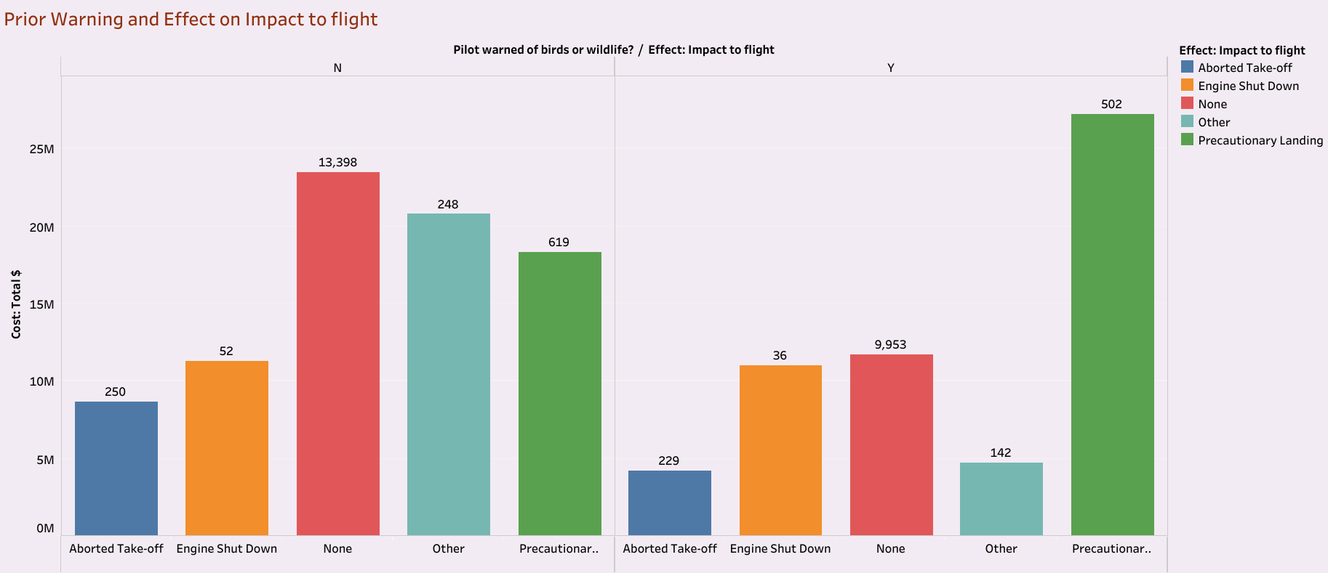
PRIOR WARNING EFFECT ON IMPACT TO FLIGHT

Slide 7
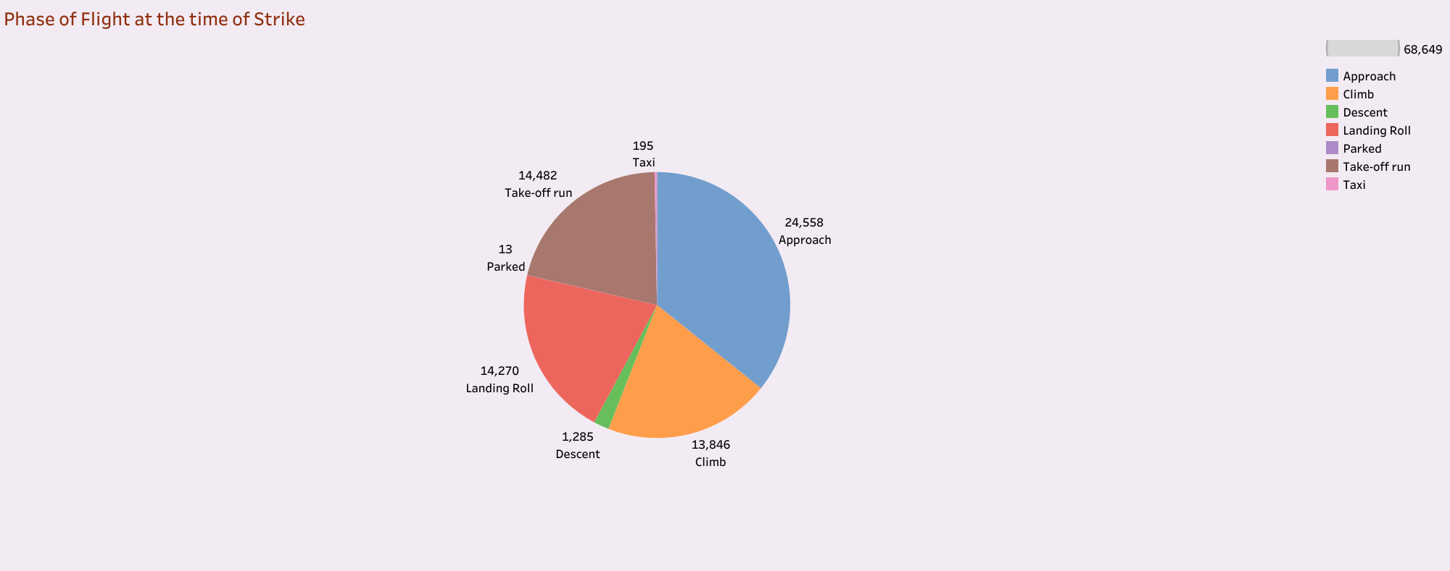
PHASE OF FLIGHT AT THE TIME OF STRIKES

Slide 8
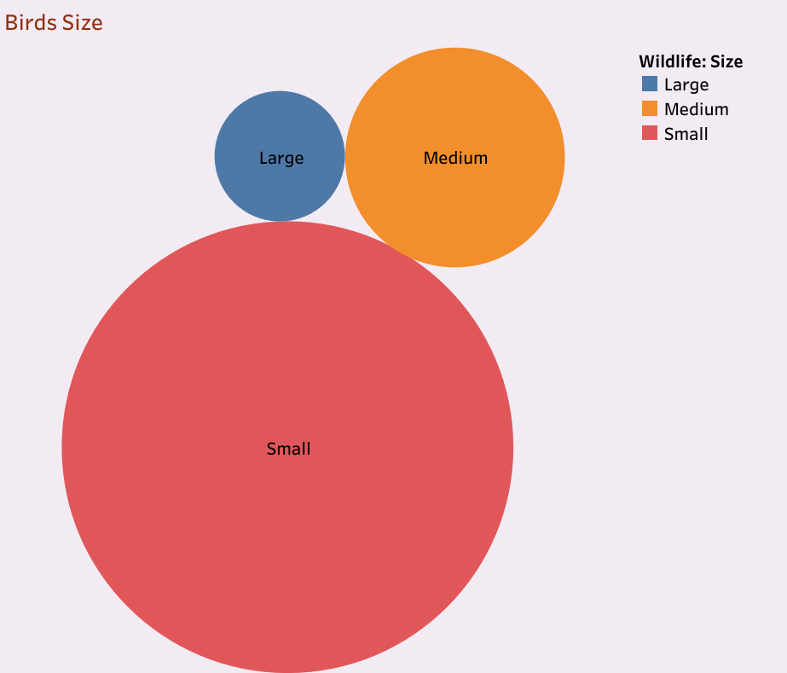
SIZE OF BIRDS

Slide 9
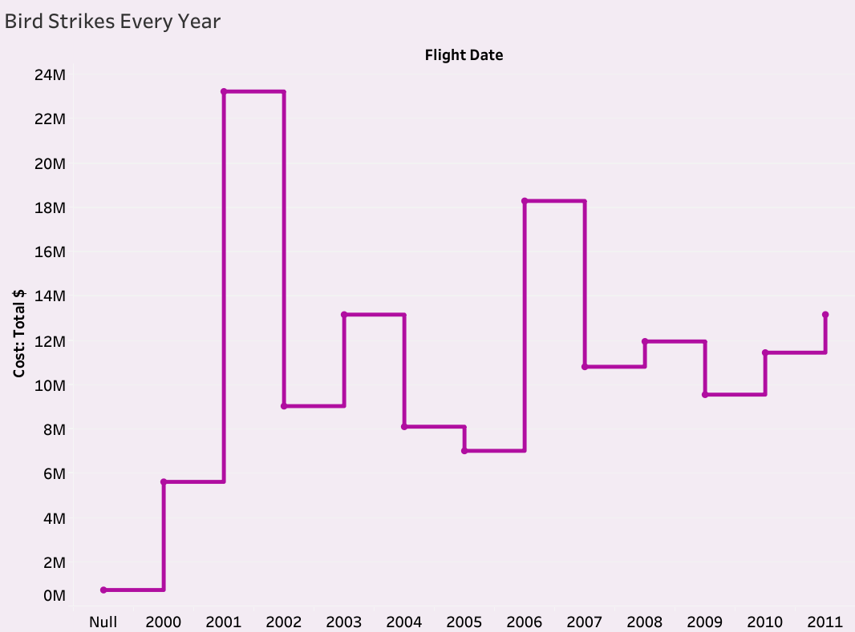
EXPENDITURE OF DAMAGED FLIGHTS IN EVERY YEAR

Slide 10
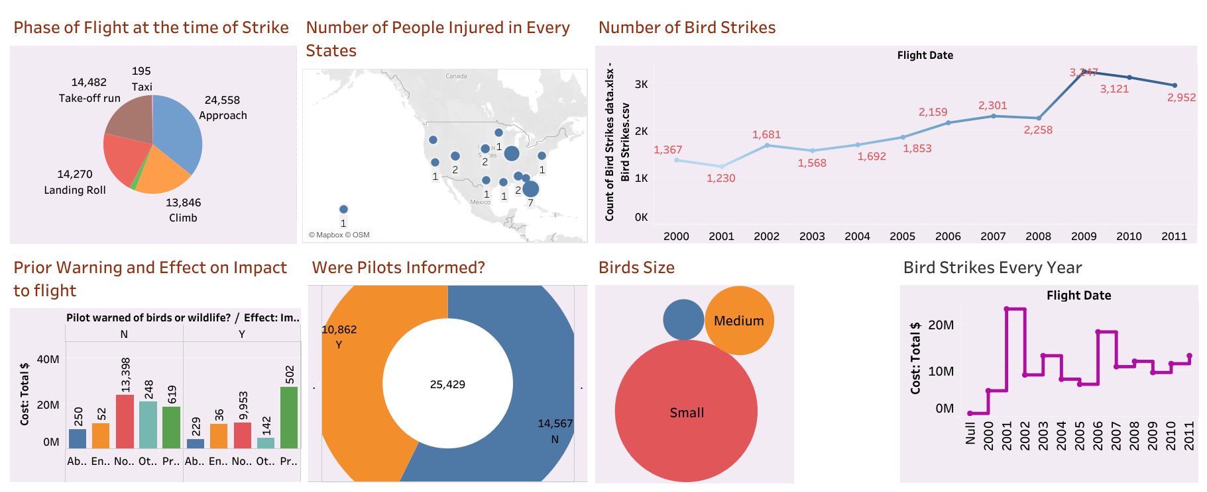
DATA VISUALIZATION ON BIRD STRIKES DASHBOARD

Slide 11
CONCLUSION
Bird strikes increased gradually every year but maximum between 2009 and 2010.
Pilots weren’t informed most of the time .So this can be an additional reason for damages caused for birds, people and flights.
Whenever Pilots were informed they did precautionary landing. It’s a best Idea they have made.
Most of the Bird Strike happened when the flights are in Approach phase.
Small birds are about to get struck mostly.
In between 2001 and 2002, the expenditure to fix the damaged Airplanes are higher compared to others.

Slide 12
THANK YOU

